Slide 1
8TH GLOBAL ISLAMIC MICROFINANCE FORUM
AKHUWAT’S MODEL OF QARZ-E-HASSAN
November 25, 2018
Dr. Amjad Saqib
W W W . A KH U W A T . O R G . P K

Slide 2
An Overview Of World Poverty
Poverty, illiteracy, poor health
Wealth of the richest eight equals that of the poorest half of humanity (3.6 billion people)
1 Billion people living at just USD 2 per day
1.7 Billion adults remain without a bank account
What is the challenge… To make this world a happy place to live in…. World Where
The World Bank (2017). Poverty. data.worldbank.org/topic/poverty?end=2014&start=2008
Oxfam (2016 & 2017). https://www.oxfam.org/en/pressroom/pressreleases/2017-01-16/just-8-men-own-same-wealth-half-world
The World Bank Group (2018). The Global Findex Database 2017: Measuring Financial Inclusion and the Fintech Revolution

Slide 3
There are many solutions but Microfinance is a key to unlock entrepreneurial potential at bottom of pyramid

Slide 4
Akhuwat Microfinance with a Difference
Shariah Compliant
Interest Free
Partnership

Slide 5
Akhuwat - Vision
A Poverty-Free Society built on the principles of compassion and equity

Slide 6
Akhuwat - Philosophy
Derived from the concept of MAWAKHAAT, meaning ‘solidarity’ or ‘brotherhood’ following the tradition of Holy Prophet (PBUH)

Slide 7
Akhuwat - Story
The story begins in 2001 with the first interest-free loan of US $ 100 to a widow

Slide 8
Akhuwat - Principles
Interest-free Loans
Use of Religious Places
Spirit of Volunteerism
Transforming Borrowers into Donors
Non-Discrimination on Cast, Color Creed, Political Affiliation & Faith
Promotion of Business Ethics and Entrepreneurship

Slide 9
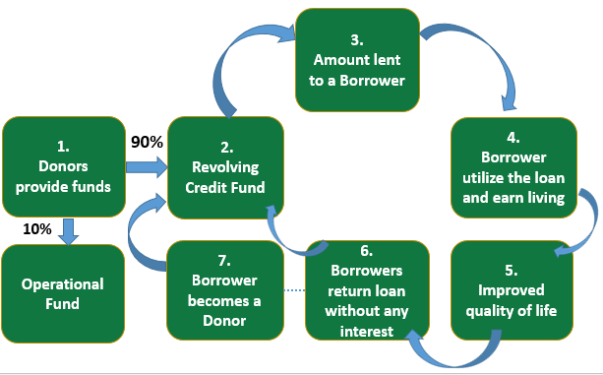
Akhuwat - How It Works?

Slide 10
Akhuwat - Types Of Loans
Health (0.3%)
Liberation (0.3%)
Enterprise (98.20%)
Marriage (0.4%)
Housing (0.5%)
Emergency (0.1%)
Education (0.2%)

Slide 11
Akhuwat - Impact
Started in 2001 with a small loan of US$ 100 – Nov 2018
Total Benefiting Families | 3 Million
Total Amount Disbursed | US$ 700 Million
Recovery Rate | 99.94%
Active Loans | 965,000
Number of Branches | 816
Number of Cities/Towns | 400
Exchange Rate: PKR 130 = US$ 1 | as at Oct 31st, 2018

Slide 12
World’s Largest Interst-free MFI Alhamdulillah
1st
1st
1st
Largest Microfinance Provider in terms of Active Loans
Largest Microfinance Provider in Terms of Geographical Spread in Pakistan
Largest Microfinance Provider in Terms of % Age of
Market Share
985,000
Active Loans
88
Districts
14.8%
Micro Watch Issue 49: Quarter 3 (July-September 2018)

Slide 13
Public Private Partnerships
In addition Akhuwat’s own programme, a revolving fund has been set up by the public sector – Akhuwat is the implementing partner:
Chief Minister Self Employment Scheme- Punjab , Gilgit Baltistan and KP
Prime Minister Interest Free Loan Scheme (25 Partners)
Governor KP, Interest Free Loan Scheme in FATA
Akhuwat – TEVTA Interest Free Loan Scheme
Empowerment of Kissan through Financial and Digital Inclusion
Interest Free loans for Disabled

Slide 14
Akhuwat - International Partnerships
Akhuwat implements programs with international partners as well :
Lendwithcare (Care International, UK)
British Asian Trust (BAT) headed by HRH Prince Charles of Wales
University of Oxford & LUMS
UNDP & USAID

Slide 15
Akhuwat - Academic Partnerships

Slide 16
Akhuwat – New Horizons
Akhuwat Interest Free
Micro-financing
Akhuwat Educational Services
Akhuwat Clothes Bank
Akhuwat Health Services
Akhuwat Transgender Support Program
DONATE ONLINE
W W W . D O N A T E . A K U W A T . O R G . P K
042-35122222 | 042-35122743 | 042-35156382 UAN: 111-448-464 | Fax: 042-35157257
19-Civic, Sector A-2, Township, Lahore www.akhuwat.org.pk

Slide 17
Video by Wall Street Journal

Slide 18
Video – World Economic Forum

Slide 19
Thank You
FOR MORE Information
akhuwat.org.pk

